Slide 1
Jacqui Chetty (module lead)
I will be teaching weeks 1 to 3

Slide 2
Fundamentals of Python: First Programs Second Edition
Chapter 1
Introduction

Slide 3
Objectives
1.1 Describe the basic features of an algorithm
1.2 Explain how hardware and software collaborate in a computer’s architecture
1.3 Give a brief history of computing
1.4 Compose and run a simple Python program

Slide 4
Two Fundamental Ideas of Computer Science: Algorithms and Information Processing
Computer science focuses on a broad set of interrelated ideas
Two of the most basic ones are:
Algorithms
Information processing

Slide 5
Algorithms (1 of 2)
Steps for subtracting two numbers:
Step 1: Write down the numbers, with larger number above smaller one, digits column-aligned from right
Step 2: Start with rightmost column of digits and work your way left through the various columns
Step 3: Write down difference between the digits in the current column of digits, borrowing a 1 from the top number’s next column to the left if necessary
Step 4: If there is no next column to the left, stop
Otherwise, move to column to the left; go to Step 3
The computing agent is a human being
Sequence of steps that describes each of these computational processes is called an algorithm

Slide 6
Algorithms (2 of 2)
Features of an algorithm:
Consists of a finite number of instructions
Each individual instruction is well defined
Action described by the instruction can be performed effectively or be executed by a computing agent
Describes a process that eventually halts after arriving at a solution to a problem
Solves a general class of problems
Computers can be designed to run a small set of algorithms for performing specialized tasks

Slide 7
Information Processing
Information is also commonly referred to as data
In carrying out the instructions of an algorithm, computing agent manipulates information
Starts with input
Transforms information according to well-defined rules
Produces output
The algorithms that describe information processing can also be represented as information
Computer scientists recently discovered how to represent many other things, such as:
Images, music, human speech, and video

Slide 8
The Structure of a Modern Computer System
A modern computer system consists of hardware and software
Hardware: physical devices required to execute algorithms
Software: set of these algorithms, represented as programs in particular programming languages

Slide 9
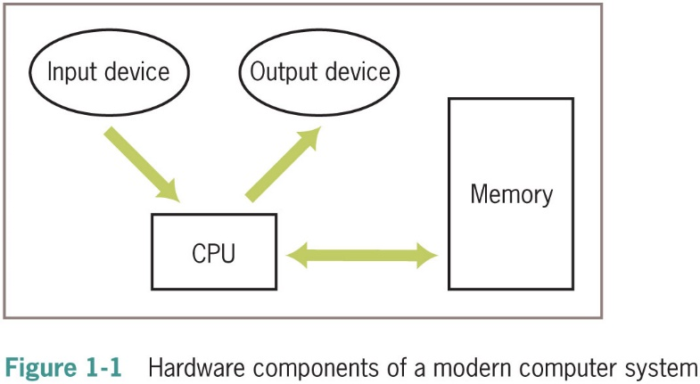
Computer Hardware (1 of 3)
Basic hardware components of a computer are:
Memory
Central processing unit (C P U)
Set of input/output devices
Computers can also communicate with the external world through various ports that connect them to networks and to other devices

Slide 10
Computer Hardware (2 of 3)
Computer memory is set up to represent and store information in electronic form
Stored as patterns of binary digits (1s and 0s)
Random access memory (R A M) is also called internal or primary
Part of a computer responsible for processing data is the central processing unit (C P U), also called processor
External or secondary memory can be magnetic, semiconductor, or optical

Slide 11
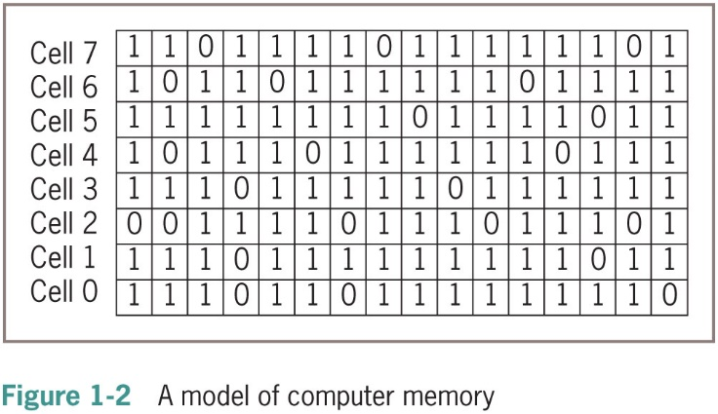
Computer Hardware (3 of 3)

Slide 12
Computer Software (1 of 3)
A program stored in computer memory must be represented in binary digits, or machine code
A loader takes a set of machine language instructions as input and loads them into the appropriate memory locations
The most important example of system software is a computer’s operating system
Some important parts: file system, user interfaces (terminal-based, G U Is, or touchscreen interface)
Applications include Web browsers, word processors, spreadsheets, database managers, graphic design packages, games, etc…

Slide 13
Computer Software (2 of 3)
Scientists have developed high-level programming languages for expressing algorithms
Resemble English and allow the author to express algorithms in a form that other people can understand
Programmers usually start by writing high-level language statements in a text editor
Runs another program called a translator to convert program code into executable code
Translator checks for syntax errors
If no errors are found, program can be executed by the run-time system
Might execute program directly on the hardware or run another program called an interpreter or virtual machine to execute the program

Slide 14
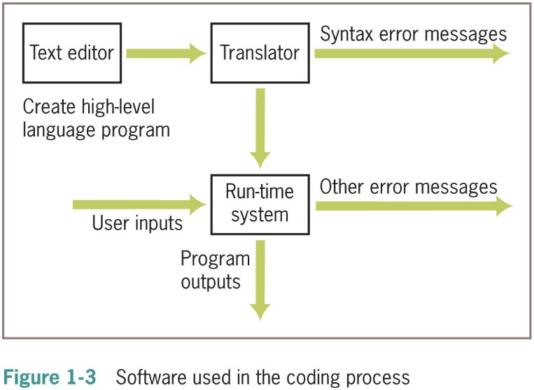
Computer Software (3 of 3)

Slide 15
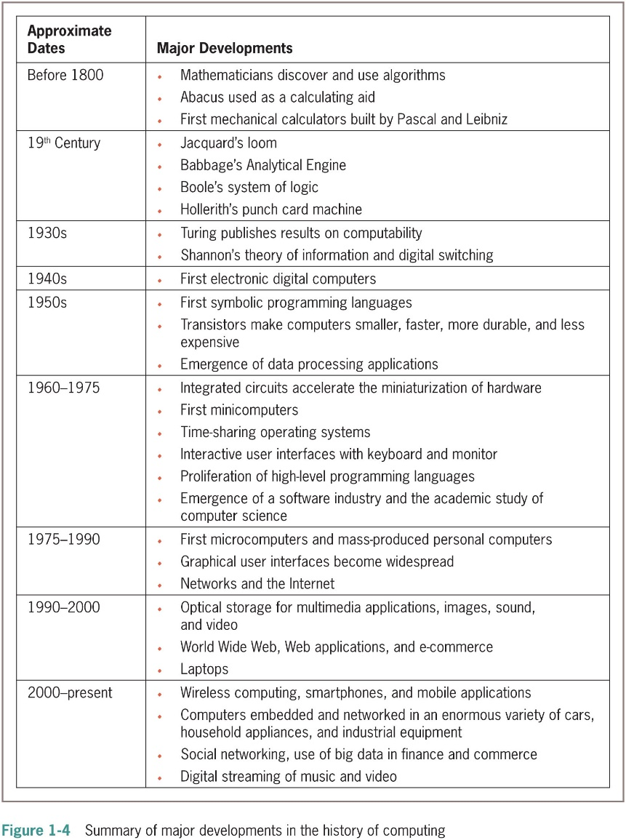
A Not-So-Brief History of Computing Systems

Slide 16
Before Electronic Digital Computers (1 of 4)
“Algorithm” comes from Muhammad ibn Musa Al-Khawarizmi, a Persian mathematician
Euclid developed an algorithm for computing the greatest common divisor of two numbers
The abacus also appeared in ancient times
Blaise Pascal (1623–1662): built one of the first mechanical devices to automate addition
Wilhelm Leibniz (1646-1716): built another calculator that included other arithmetic functions such as multiplication
Joseph Jacquard (1752–1834): designed and constructed a machine that automated weaving

Slide 17
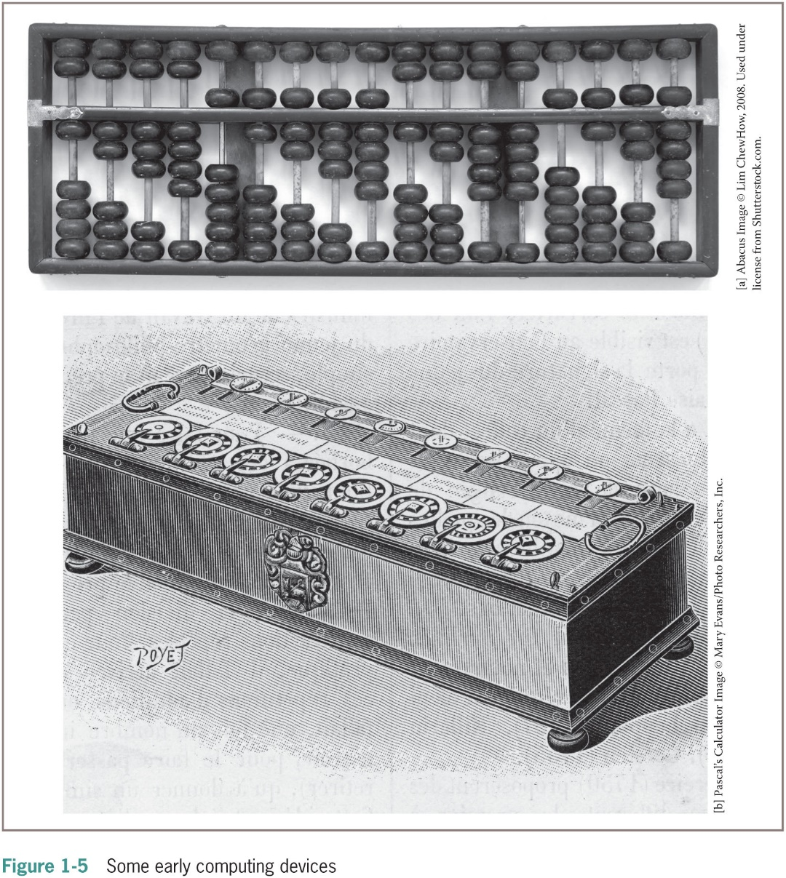
Before Electronic Digital Computers (2 of 4)

Slide 18
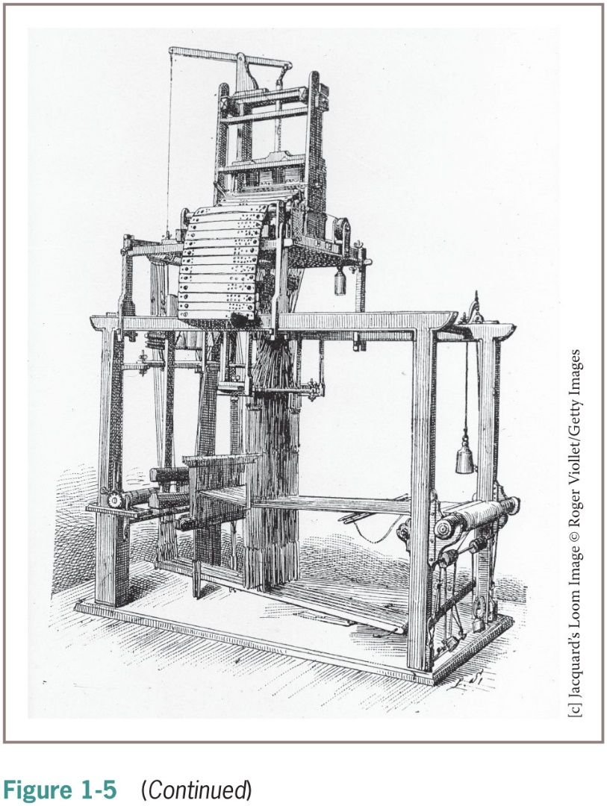
Before Electronic Digital Computers (3 of 4)

Slide 19
Before Electronic Digital Computers (4 of 4)
Charles Babbage (1792–1871): conceived Analytical Engine
Herman Hollerith (1860–1929): developed a machine that automated data processing for the U.S. Census
One of the founders of company that became I B M
George Boole (1815–1864): developed Boolean logic
Alan Turing (1912–1954): explored the theoretical foundations and limits of algorithms and computation

Slide 20
The First Electronic Digital Computers (1940-1950)
Late 1930s: Claude Shannon wrote paper titled “A Symbolic Analysis of Relay and Switching Circuits”
1940s:
Mark I (electromechanical)
E N I A C (Electronic Numerical Integrator and Calculator)
A B C (Atanasoff-Berry Computer)
Colossus by a group working under Alan Turing
John von Neumann: first memory-stored programs
Mainframe computers consisted of vacuum tubes, wires, and plugs, and filled entire rooms

Slide 21
The First Programming Languages (1950-1965)
The first assembly languages had operations like ADD and OUTPUT
Programmers entered mnemonic codes for operations at keypunch machine
Card reader—translated holes in cards to patterns in computer’s memory
Assembler—translated application programs in memory to machine code
Compiler – translated programs to machine code
High-level programming languages: FORTRAN, LISP, COBOL
common feature: abstraction

Slide 22
Integrated Circuits, Interaction, and Timesharing (1965-1975)
Late 1950s: vacuum tube gave way to transistor
Transistor is solid-state device
Early 1960s: integrated circuit enabled smaller, faster, less expensive hardware components
Moore’s Law: processing speed and storage capacity of HW will increase and cost will decrease by approximately a factor of 2 every 18 months
Minicomputers appeared
Processing evolved from:
Batch processing
Time-sharing
Concurrent processing

Slide 23
Personal Computing and Networks (1975-1990)
Late 1960s: Douglas Engelbart
First pointing device (mouse) and software to represent windows, icons, and pull-down menus on a bit-mapped display screen
Member of team that developed Alto (Xerox PARC)
1975: Altair, first mass-produced personal computer
With Intel’s 8080 processor, first microcomputer chip
Early 1980s: Gates and Allen build MS-D O S
Bob Metcalfe created Ethernet, used in LANs
ARPANET grew into what we call Internet

Slide 24
Consultation, Communication, and E-Commerce (1990-2000) (1 of 2)
Optical storage media was developed for mass storage
Virtual reality: capacity to create lifelike 3-D animations of whole-environments
Berners-Lee at CERN created W W W
Based on concepts of hypermedia
H T T P: Hypertext Transfer Protocol
H T M L: Hypertext Markup Language
Components of W W W:
Web servers
Web browsers
Web clients

Slide 25
Consultation, Communication, and E-Commerce (1990-2000) (2 of 2)
Web applications – presented a revolution in the way software services were delivered to people
Made online stores pervasive
Web application providing the service ran on a remote computer or server
Client/server applications – such as e-mail, bulletin boards, and chat rooms
Were already in use
Simply deployed on the Web when it became available
Sergey Brin and Larry Page
Developed algorithms for indexing and searching the Web

Slide 26
Mobile Applications and Ubiquitous Computing (2000-present)
Personal digital assistants (P D A s) – first handheld computing devices
Limited to video games, address books, to-do lists, and note taking
Steve Jobs (Apple) created several key devices
iPod
iPhone
iPad
Social networking applications – major addition to the digital landscape
Big data – a technology where governments, businesses, and hackers continually monitor Internet traffic
Researchers have created algorithms that process massive amounts of data to discover trends and predict outcomes

Slide 27
Getting Started with Python Programming
Early 1990s: Guido van Rossum
invented the Python programming language
Python is a high-level, general-purpose programming language for solving problems on modern computer systems
Useful resources at www.python.org

Slide 28
Running Code in the Interactive Shell (1 of 2)
Python is an interpreted language
Simple Python expressions and statements can be run in the shell
Easiest way to open a Python shell is to launch the I D L E
To quit, select the window’s close box or press Control+D
Shell is useful for:
Experimenting with short expressions or statements
Consulting the documentation

Slide 29
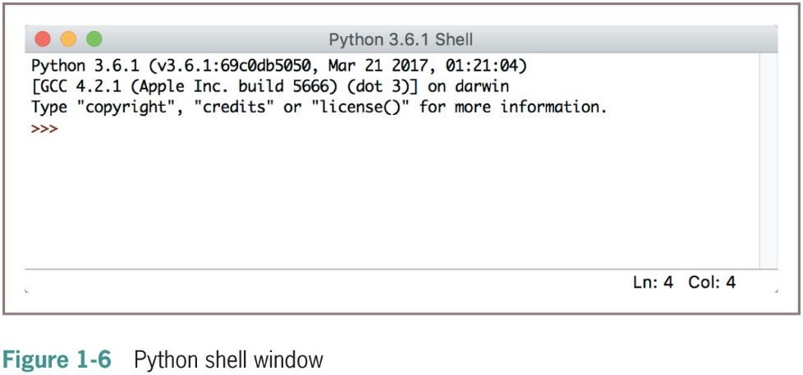
Running Code in the Interactive Shell (2 of 2)

Slide 30
Input, Processing, and Output (1 of 5)
Programs usually accept inputs from a source, process them, and output results to a destination
In terminal-based interactive programs, these are the keyboard and terminal display
In Python, inputs are Python expressions or statements
Outputs are the results displayed in the shell
Programmers can also force output of a value by using the print function
print (<expression>)
Example:
>>>print (“Hi there”)
Hi there

Slide 31
Input, Processing, and Output (2 of 5)
The following example receives an input string from the user and saves it for further processing:
>>> name = input(“Enter your name:”)
Enter your name: Ken Lambert
>>> name
‘Ken Lambert’
>>> print(name)
Ken Lambert
>>>

Slide 32
Input, Processing, and Output (3 of 5)
The input function always builds a string from the user’s keystrokes and returns it to the program
Strings that represent numbers must be converted from strings to appropriate number types
Two type conversion functions: int (for integers) and float (for floating-point numbers)

Slide 33
Input, Processing, and Output (4 of 5)
The next session inputs two integers and displays their sum:
>>> first = int(input(“Enter the first number: ”))
Enter the first number: 23
>>> second = int(input(“Enter the second number:”))
Enter the second number: 44
>>> print(“The sum is”, first + second)
The sum is 67

Slide 34
Input, Processing, and Output (5 of 5)
Function | What It Does
float(<a string of digits>) | Converts a string of digits to a floating-point value.
int(<a string of digits>) | Converts a string of digits to an integer value.
input(<a string prompt>) | Displays the string prompt and waits for keyboard input. Returns the string of characters entered by the user.
print(<expression>, ...,<expression>) | Evaluates the expressions and displays them, separated by one space, in the console window.
<string 1> + <string 2> | Glues the two strings together and returns the result.

Slide 35
Editing, Saving, and Running a Script (1 of 3)
We can then run Python program files or scripts within I D L E or from the O S’s command prompt
Run within I D L E using menu option, F5 (Windows), or Control+F5 (Mac or Linux)
Python program files use .py extension
Running a script from IDLE allows you to construct some complex programs, test them, and save them in program libraries to reuse or share with others

Slide 36
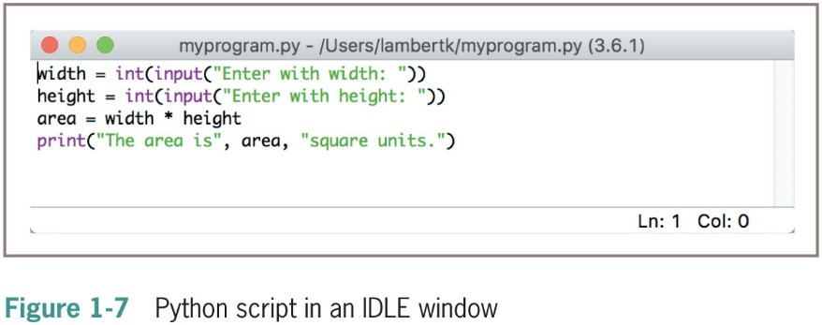
Editing, Saving, and Running a Script (2 of 3)

Slide 37
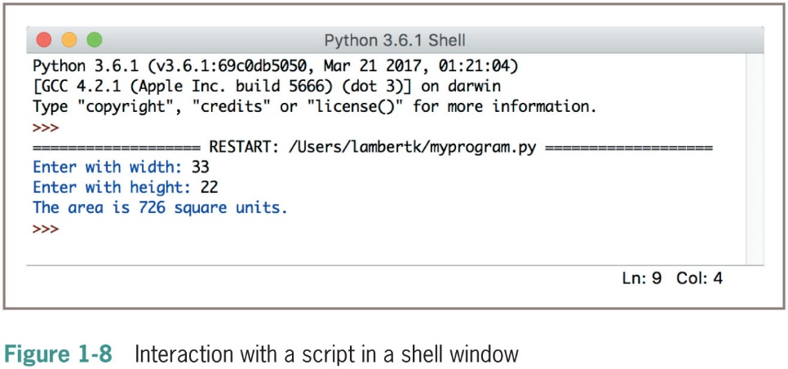
Editing, Saving, and Running a Script (3 of 3)

Slide 38
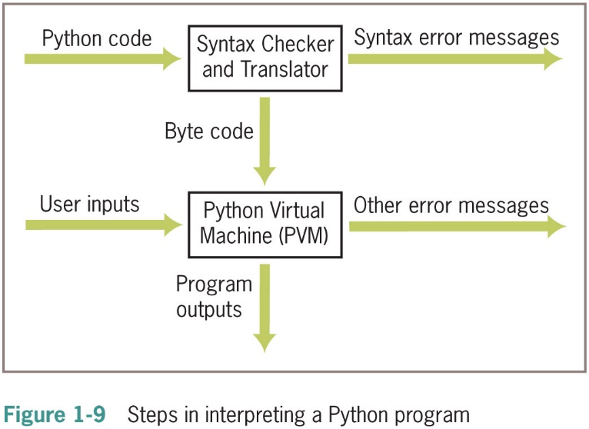
Behind the Scenes: How Python Works

Slide 39
Detecting and Correcting Syntax Errors (1 of 2)
Programmers inevitably make typographical errors when editing programs, called syntax errors
The Python interpreter will usually detect these
Syntax: rules for forming sentences in a language
When Python encounters a syntax error in a program, it halts execution with an error message
Example:
>>> length = int(input(“Enter the length: ”))
Enter the length: 44
>>> print(lenth)
Traceback (most recent call last):
File “<py shell#l>”, line 1, in <module>
NameError: name ‘lenth’ is not defined

Slide 40
Detecting and Correcting Syntax Errors (2 of 2)
The next statement attempts to print the value of the correctly spelled variable:
>>> print(length)
SyntaxError: unexpected indent
Final example, programmer attempts to add two numbers, but forgets to include the second one:
>>> 3 +
SyntaxError: invalid syntax

Slide 41
Chapter Summary (1 of 3)
Fundamental ideas of computer science
The algorithm
Information processing
Real computing agents can be constructed out of hardware devices
C P U, memory, and input and output devices
Some real computers are specialized for a small set of tasks, whereas a desktop or laptop computer is a general-purpose problem-solving machine
Software provides the means whereby different algorithms can be run on a general-purpose hardware device
Written in programming languages

Slide 42
Chapter Summary (2 of 3)
Languages such as Python are high-level
Interpreter translates a Python program to a lower-level form that can be executed on a real computer
Python shell provides a command prompt for evaluating and viewing the results of Python expressions and statements
I D L E is an integrated development environment that allows the programmer to save programs in files and load them into a shell for testing
Python scripts are programs that are saved in files and run from a terminal command prompt

Slide 43
Chapter Summary (3 of 3)
When a Python program is executed, it is translated into byte code
Sent to P V M for further interpretation and execution
Syntax: set of rules for forming correct expressions and statements in a programming language

